Slide 1




www.aegiscare.com
Intelligent Fall Monitoring System for
Elderly Care
Final Presentation
Project ID: R26_IT_051

Slide 2
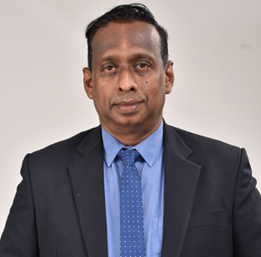
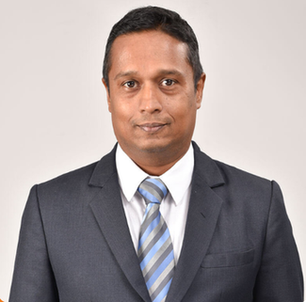


Research Team
Supervisor
Co-Supervisor
MR.Uditha Dharmakeerthi
MR.Kanishka Yapa
M T K Chathuri
Activity Recognition
D H S Diwyangi
Environmental Risk
W A H Divyanjalie
BioSignal Predictor
E D K M Kulathunga
Alert Classification
Project ID: R26_IT_051

Slide 3



WHY WE NEED THIS SYSTEM
Elderly falls are a major healthcare issue
Falls cause serious injuries
Existing systems react too late
Fractures, head injuries and loss of independence can follow a single fall.
Most systems detect a fall only after it has happened, when the harm is already done.
We need a system that predicts risk early, before the fall.
Project ID: R26_IT_051

Slide 4
RESEARCH GAP AND OBJECTIVE
Existing tools solve only one piece of the problem
The gap: each tool covers one area
Motion only
Our objective: all three together
  Recognize activities
  Check the environment
  Monitor the person's health
  Predict risk early and send the alert
Environment only
Health only
Project ID: R26_IT_051

Slide 5
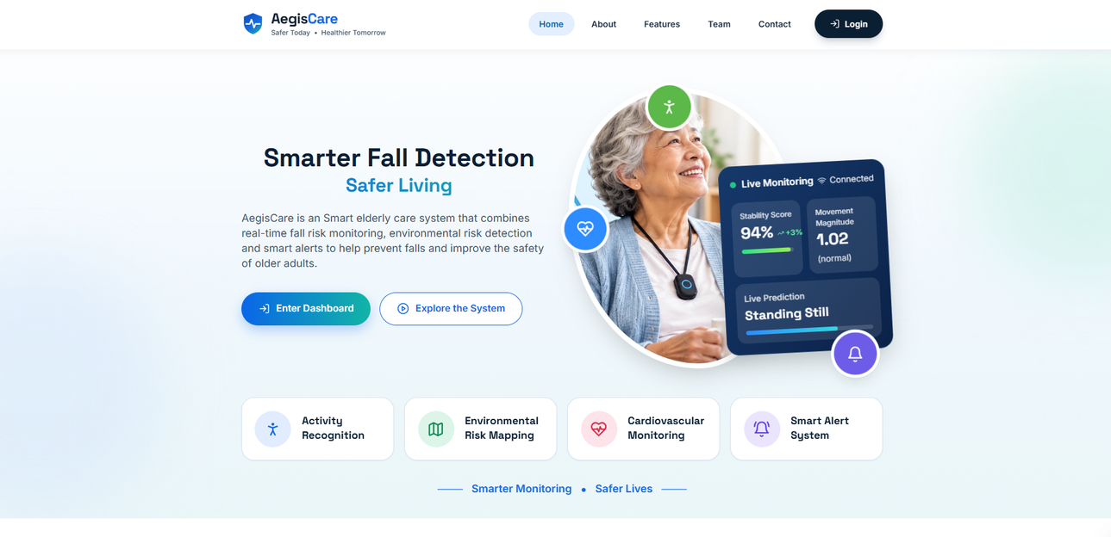


WE DEVELOPED BOTH
A website and a mobile app
Website
For hospitals and elder-care institutions
Mobile app
For caregivers
The AegisCare website
Project ID: R26_IT_051

Slide 6



STAKEHOLDERS
Who benefits from AegisCare
Caregivers & nursing staff
Hospitals & elder-care institutions
Families
Peace of mind that help is notified early.
Receive timely alerts through the mobile app.
Monitor residents through the website.
Project ID: R26_IT_051

Slide 7
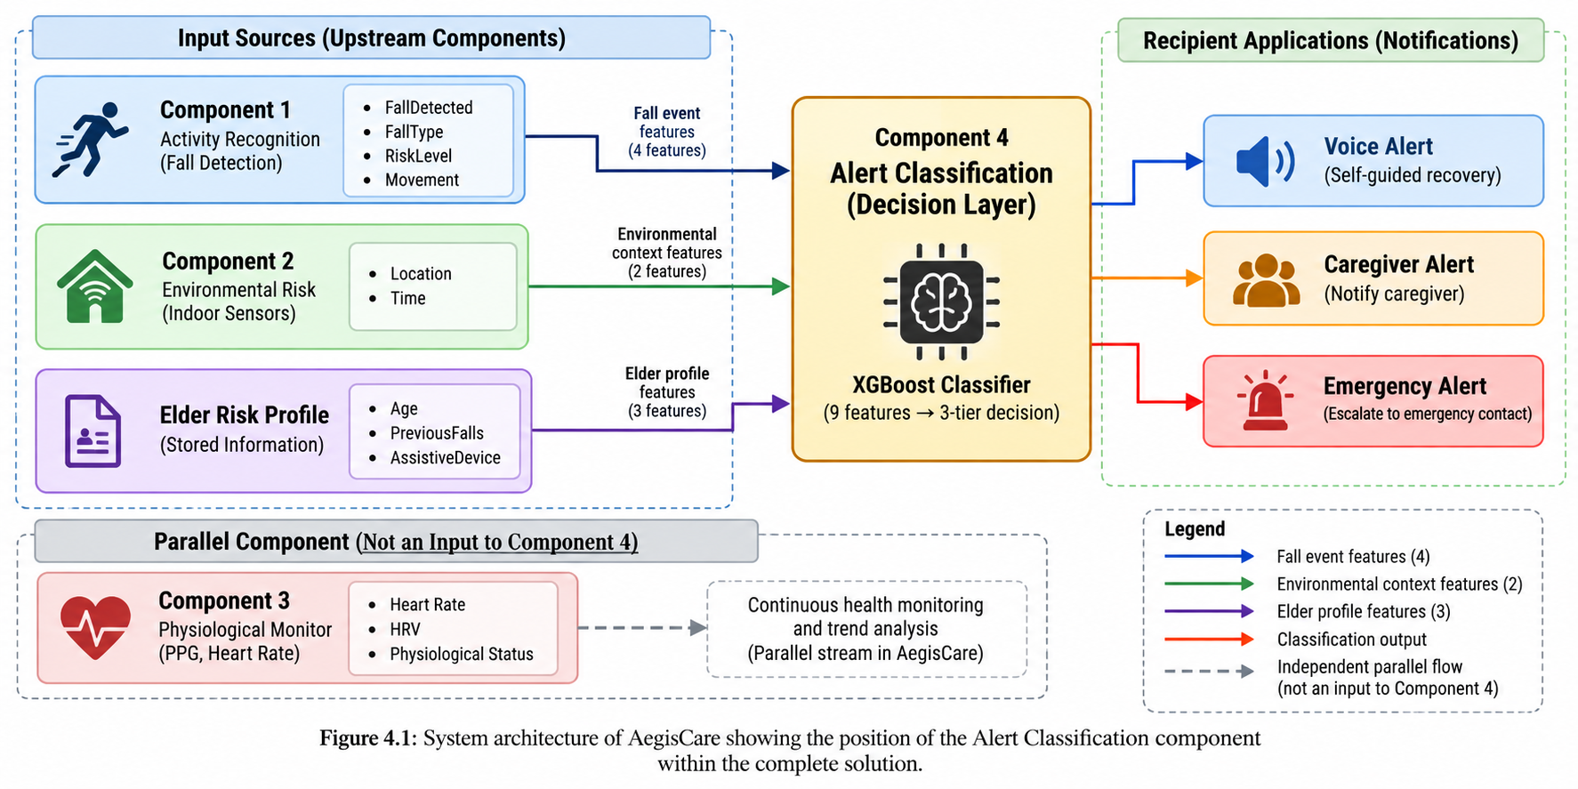
SYSTEM OVERVIEW
Project ID: R26_IT_051

Slide 8
Component 1
Context-Aware Activity Recognition
A wearable IoT system that detects falls in elderly people in real time and explains every decision.
What it is
What it does
Novelty
  Recognises standing, walking and falls
  Confirms real falls, filters false alarms
  Tells the caregiver why it decided
  Machine learning plus physics rules, not AI alone
  Context-aware: knows what came before
  Explainable alerts and a fall-risk score
A wearable sensor and a live web dashboard that watch an elderly person's posture and movement, 10 times per second.
Project ID: R26_IT_051

Slide 9
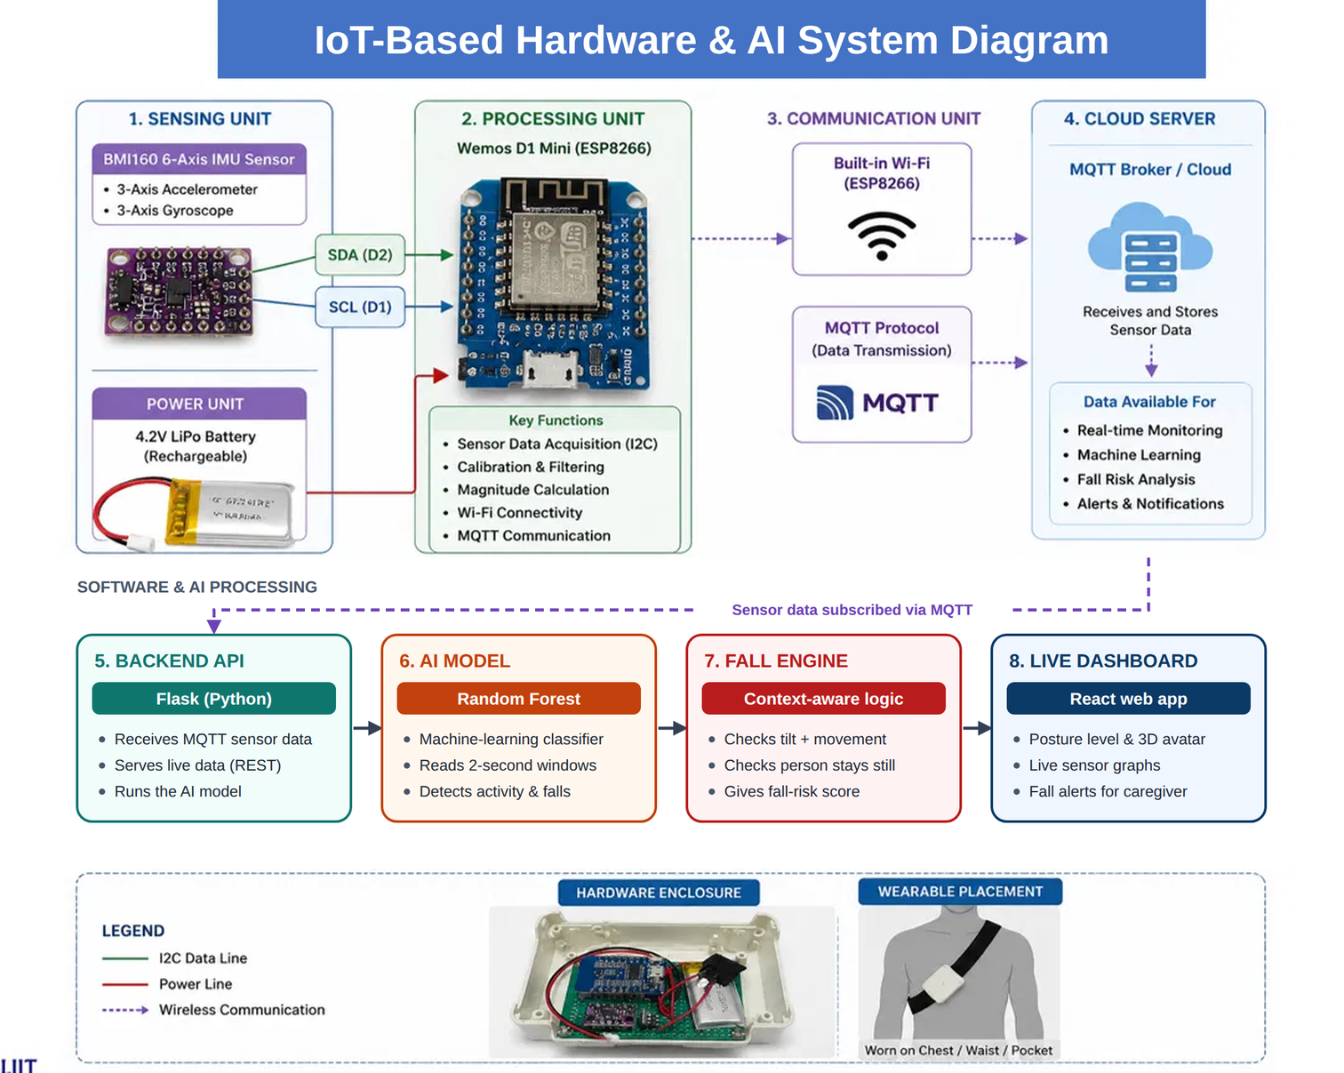
IOT Base Hardware and System Diagram
Project ID: R26_IT_051

Slide 10
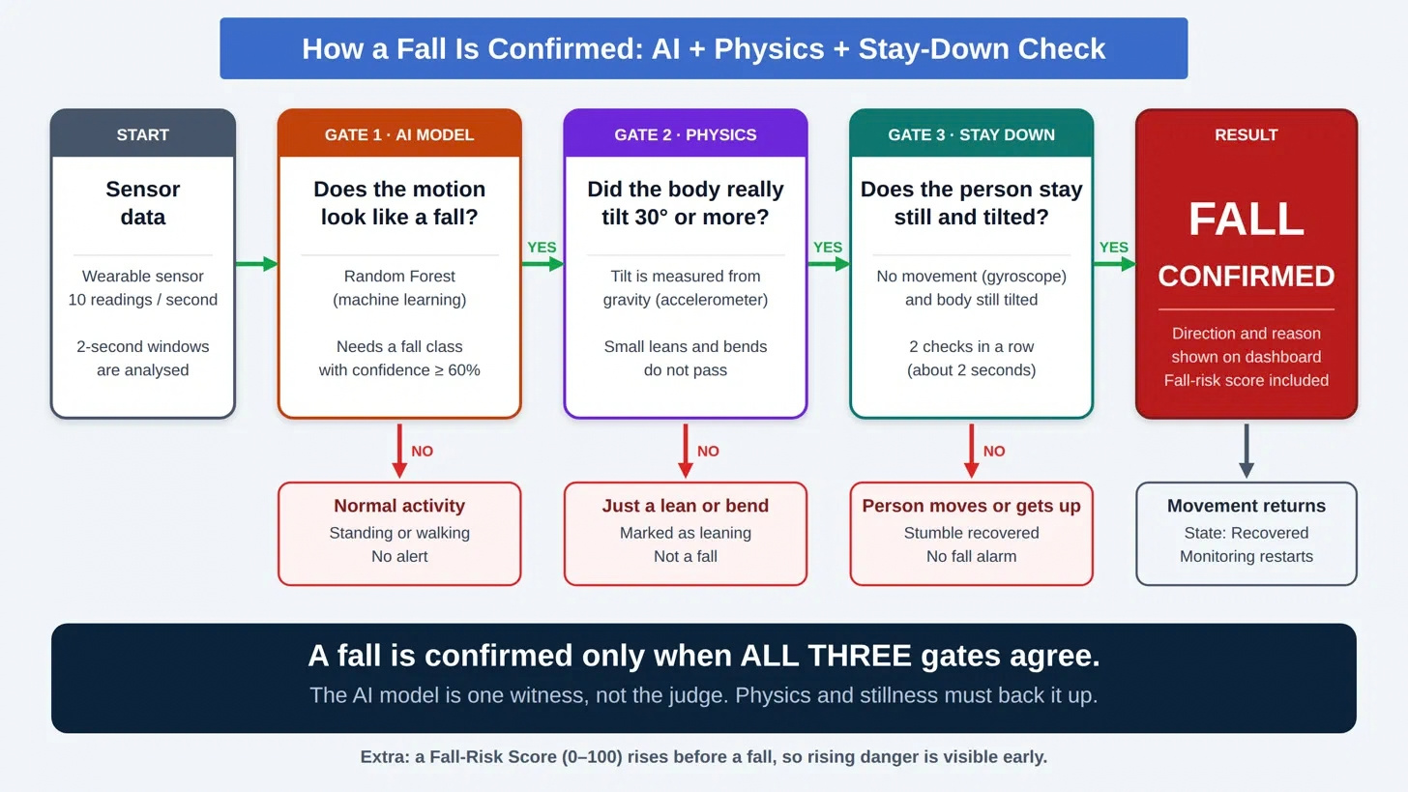
How a Fall is Confirmed:
Project ID: R26_IT_051

Slide 11
Project ID: R26_IT_051

